Slide 1

CBIR BASED IMAGE SEARCH
USING PARALLEL COMPUTING
Hemanth Kollipara

Slide 2
Abstract
“A picture is worth a thousand words”. A picture provides a lot of information that a human may not always be able to observe all the very minute details that the image contains. With the massive growth of the internet, people can gain access to a massive amount of information. Due to this retrieving the information of interest becomes very difficult. If focused on visual information, the internet contains several kinds of images and other visual information, such as videos, movies in various formats such as JPG, PNG, BMP and even GIF. Hence there is a need for such an image search engine using which the related and exact images can be searched.
Image Search Engine that is based on a content-based image retrieval query technique involves providing the CBIR system with a sample image that it will then base its search upon. CBIR seeks to find methods to index, browse, and query large image databases by using meaningful feature extraction and comparison methods for images. But to implement such kind of algorithms in real-world applications we need the algorithm to be executed in the least time possible so as to increase the performance of the system. This speed-up of performance can be achieved by using the concept of parallel computing. Implementation of parallelization in image search could greatly reduce the retrieval time and improve the performance of retrieval system which is critical in any search applications. Applications of feature extraction from images are limitless. This data can be used in classification, recognition of images in a huge database centers where processing needs to be fast and efficient.

Slide 3
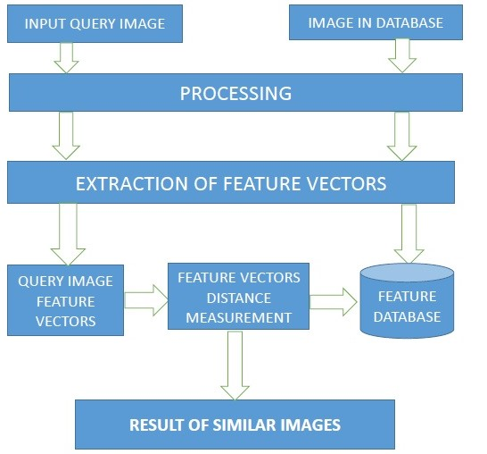
PROPOSED BASE ARCHITECTURE

Slide 4
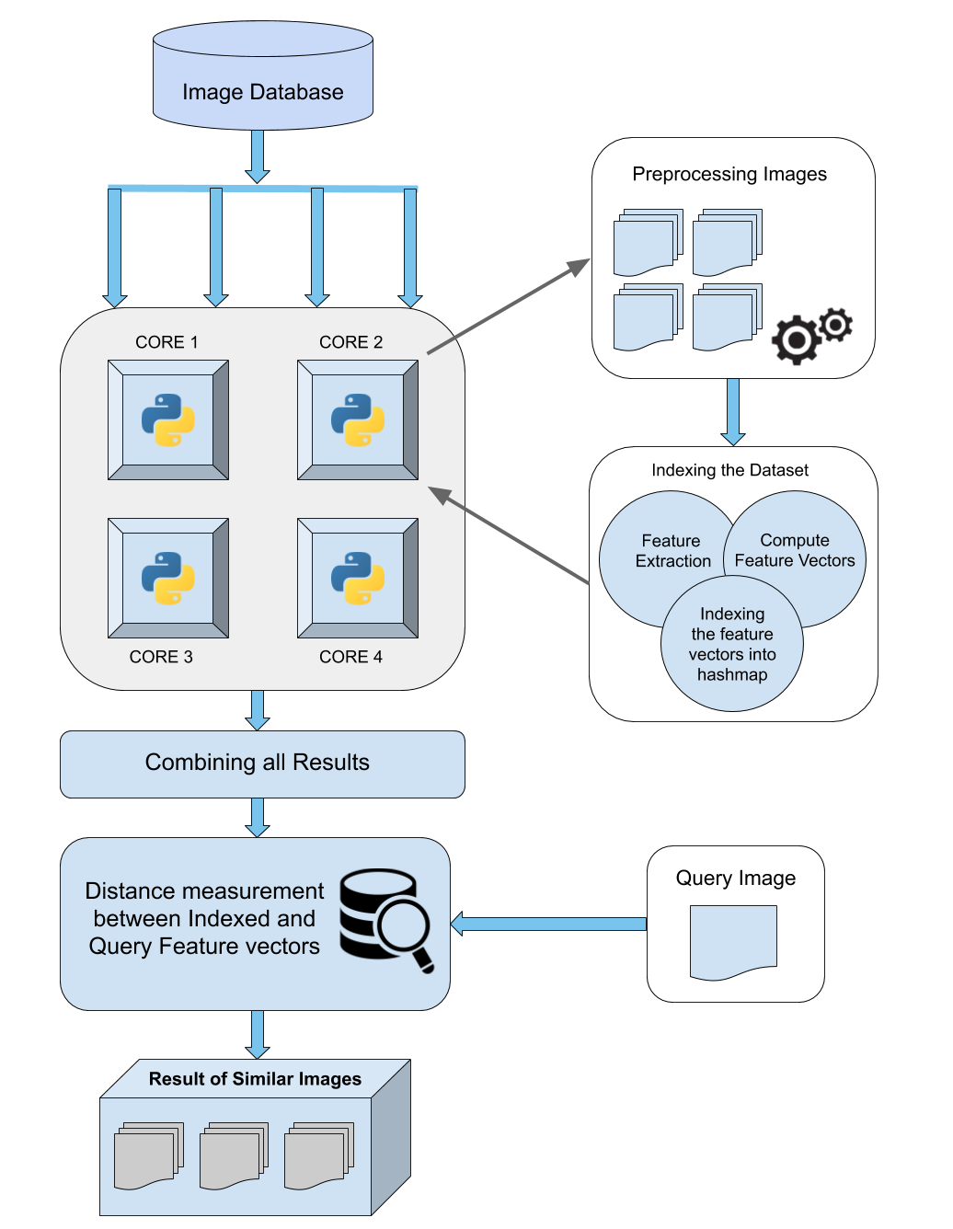
PROPOSED PARALLEL ARCHITECTURE

Slide 5
PRE-PROCESSING TECHNIQUES
RESIZING
GRAY SCALING
CONVOLUTION FILTERS
NOISE REDUCTION
IMAGE SHARPENING

Slide 6
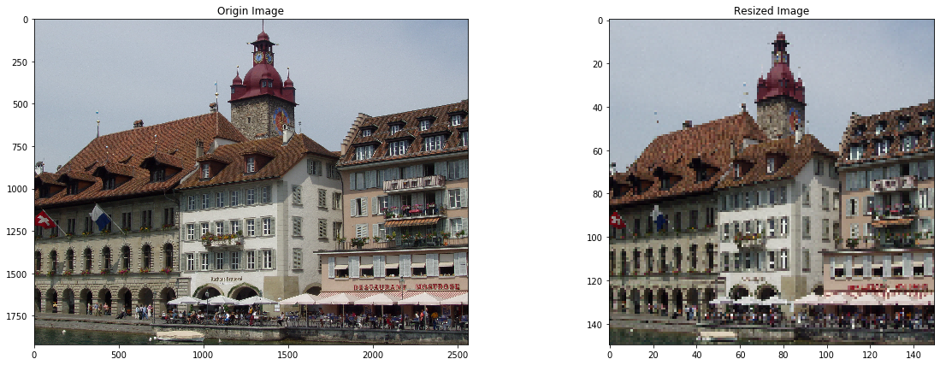
RESIZING

Slide 7
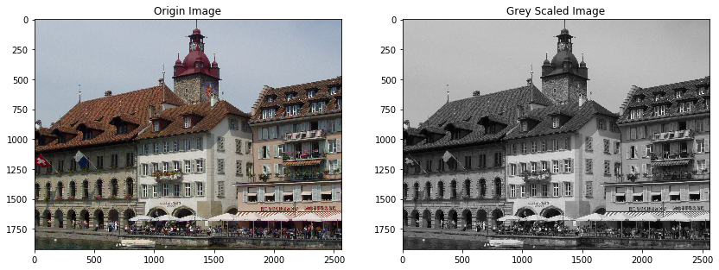
GREY SCALING

Slide 8
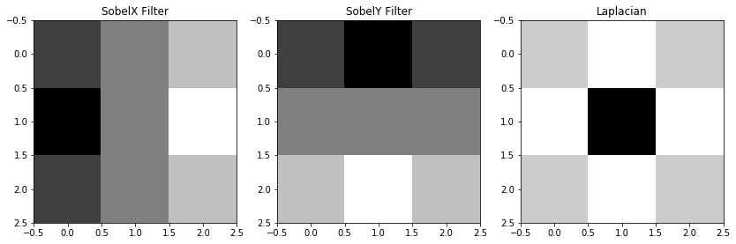
CONVOLUTION KERNEL
A Kernel is a matrix of numbers that modifies an image
-1 | 0 | 1
-2 | 0 | 2
-1 | 0 | 1
-1 | -2 | -1
0 | 0 | 0
1 | 2 | 1
0 | 1 | 0
1 | -4 | 1
0 | 1 | 0

Slide 9
CONVOLVING WITH IMAGE

Slide 10
CONVOLVING WITH IMAGE

Slide 11
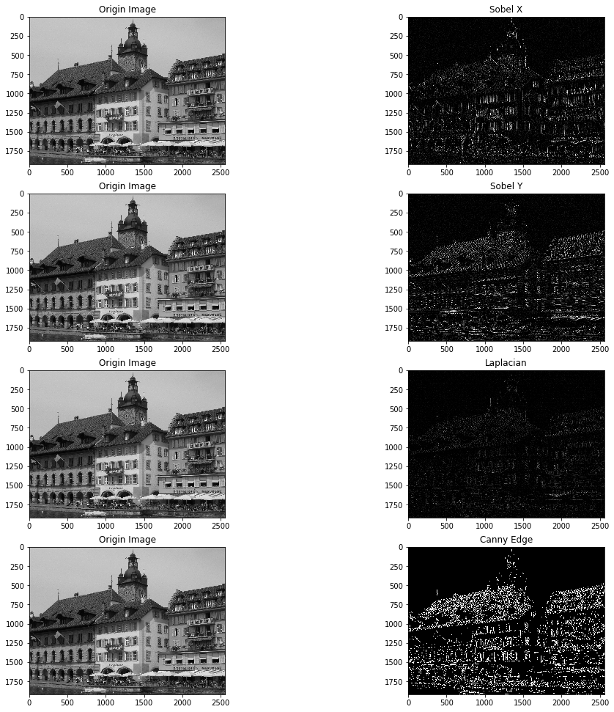
APPLYING CONVOLUTION FILTERS

Slide 12
APPLYING CONVOLUTION FILTERS

Slide 13
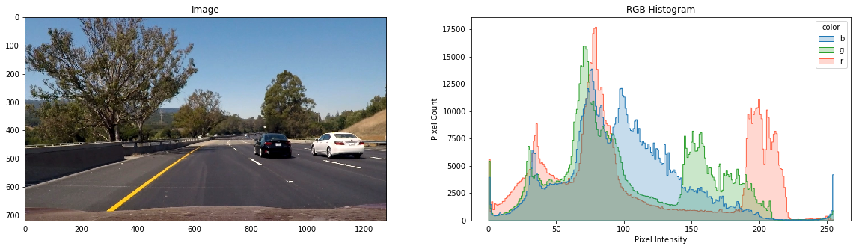
RGB DISTRIBUTION PLOT USING HISTOGRAMS

Slide 14
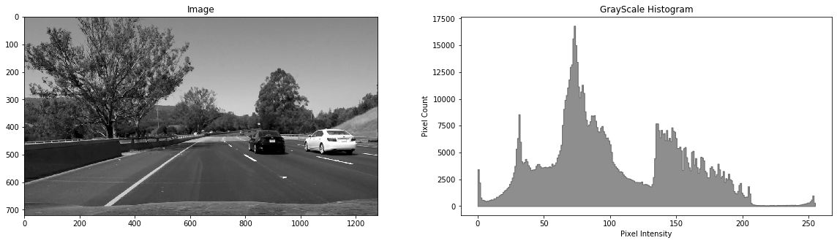
GREY SCALE DISTRIBUTION PLOT

Slide 15
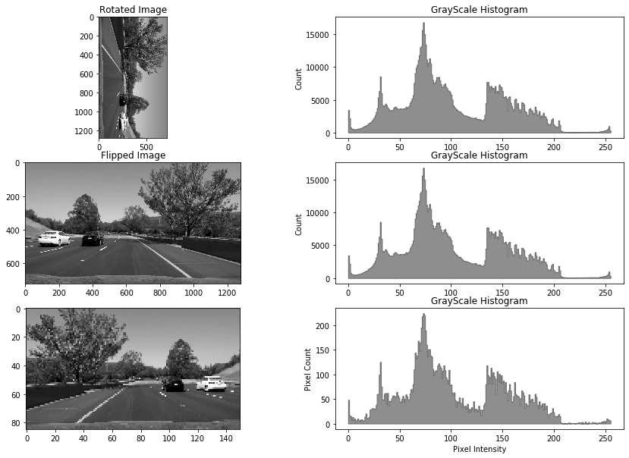
ROTATION & FLIP & ROTATION TOLERANCE

Slide 16
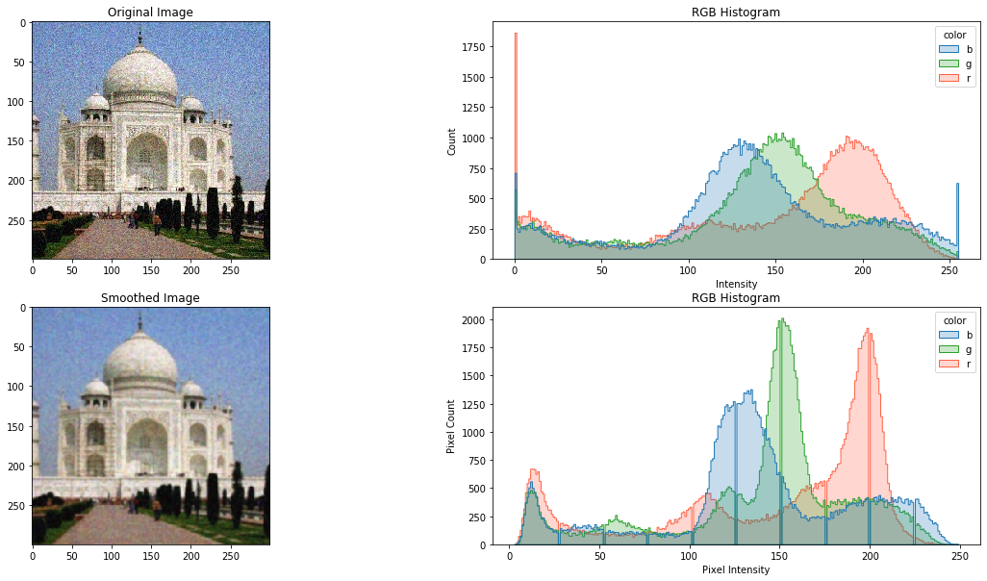
NOISE REDUCTION

Slide 17
PROGRESS
STAGE 01
Collecting a Dataset of Images.
STAGE 03
Feature extraction and Indexing Feature vectors of database images.
STAGE 05
Parallelization of entire Architecture
STAGE 02
Image pre-processing
using convolutional Filters
STAGE 04
Similarity measurement of query vectors and indexed vectors.

